Slide 1

INFORMATION SYSTEM
UNIT 03 : INFORMATION SYSTEM ANALYSIS AND DESIGN
© 2018, PRAMOD PARAJULI

Slide 2
Disclaimer
These slides are part of teaching materials for Information System (IS). These slides do not cover all aspect of learning IS, nor are these to be taken as primary source of information. As the core textbooks and reference books for learning the subject has already been specified and provided to the students, students are encouraged to learn from the original sources.
Contents in these slides are copyrighted to the instructor and authors of original texts where applicable.

Slide 3
INFORMATION SYSTEMS analysis and design
3.1. System Requirement Analysis – Joint Application Design (JAD), Prototyping, Structured Analysis, Data Flow Diagram (DFD)
3.2. Design Specification – Object Modeling
3.3 Use Cases, Activity Diagrams, Sequence Diagram
3.4 Entity, Attribute, Entity – Relationship Diagram (→ to Unit 4)
3.5 Object Diagrams, Class Diagrams
3.6 Operators, Associations, Generalization and Aggregation

Slide 4
3. Information System Analysis and Design
References - - - - - - - - Valacich and George, Modern Systems Analysis and Design, 8th Ed., Pearson, Chapter 6, 7

Slide 5
Learning Objectives
Describe options for designing and conducting interviews and develop a plan for conducting an interview to determine system requirements.
Explain the advantages and pitfalls of observing workers and analyzing business documents to determine system requirements.
Explain how computing can provide support for requirements determination.
Participate in and help plan a Joint Application Design session.

Slide 6
Learning Objectives (Cont.)
Use prototyping during requirements determination.
Describe contemporary approaches to requirements determination.
Understand how requirements determination techniques apply to the development of electronic commerce applications.

Slide 7
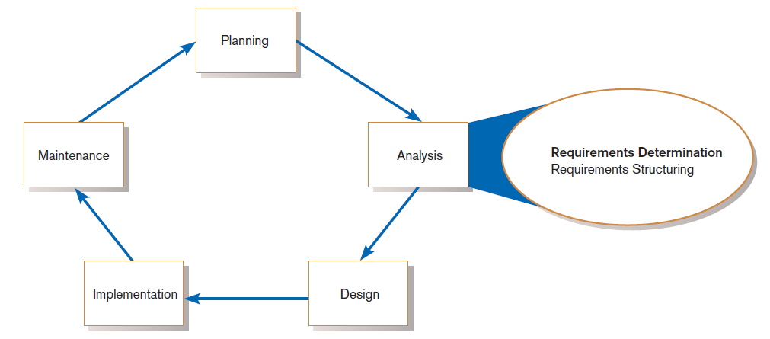
Performing Requirements Determination
FIGURE 6-1
Systems development life cycle with analysis phase highlighted

Slide 8
The Process of Determining Requirements
Good Systems Analyst Characteristics:
Impertinence—question everything
Impartiality—consider all issues to find the best organizational solution
Relax constraints—assume anything is possible
Attention to details—every fact must fit
Reframing—challenge yourself to new ways

Slide 9
Deliverables and Outcomes
Deliverables for Requirements Determination:
From interviews and observations
interview transcripts, observation notes, meeting minutes
From existing written documents
mission and strategy statements, business forms, procedure manuals, job descriptions, training manuals, system documentation, flowcharts
From computerized sources
Joint Application Design session results, CASE repositories, reports from existing systems, displays and reports from system prototype

Slide 10
Traditional Methods for Determining Requirements
Interviewing individuals
Interviewing groups
Observing workers
Studying business documents

Slide 11
Interviewing and Listening
One of the primary ways analysts gather information about an information systems project
An interview guide is a document for developing, planning and conducting an interview.

Slide 12
Guidelines for Effective Interviewing
Plan the interview.
Prepare interviewee: appointment, priming questions.
Prepare agenda, checklist, questions.
Listen carefully and take notes (tape record if permitted).
Review notes within 48 hours.
Be neutral.
Seek diverse views.

Slide 13
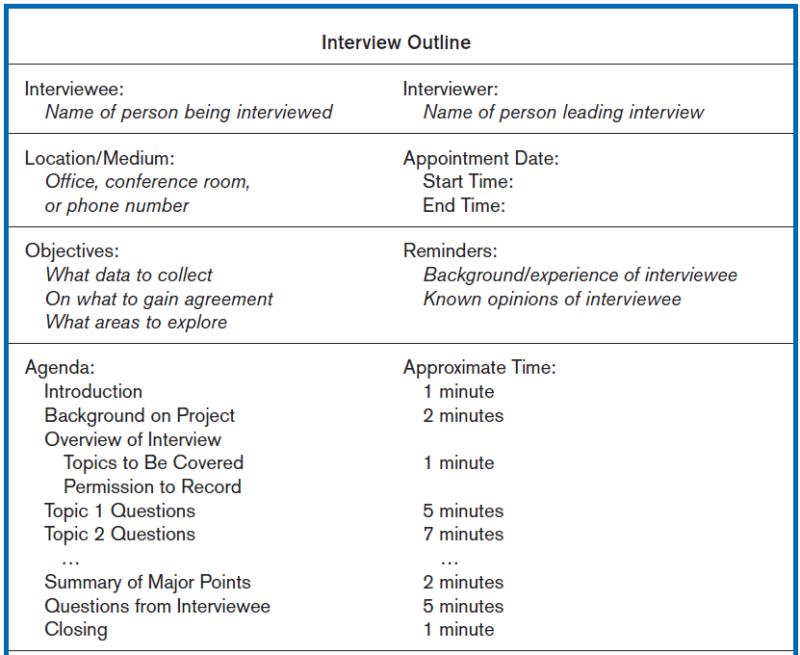
Interviewing and Listening (Cont.)
FIGURE 6-2 Typical interview guide

Slide 14
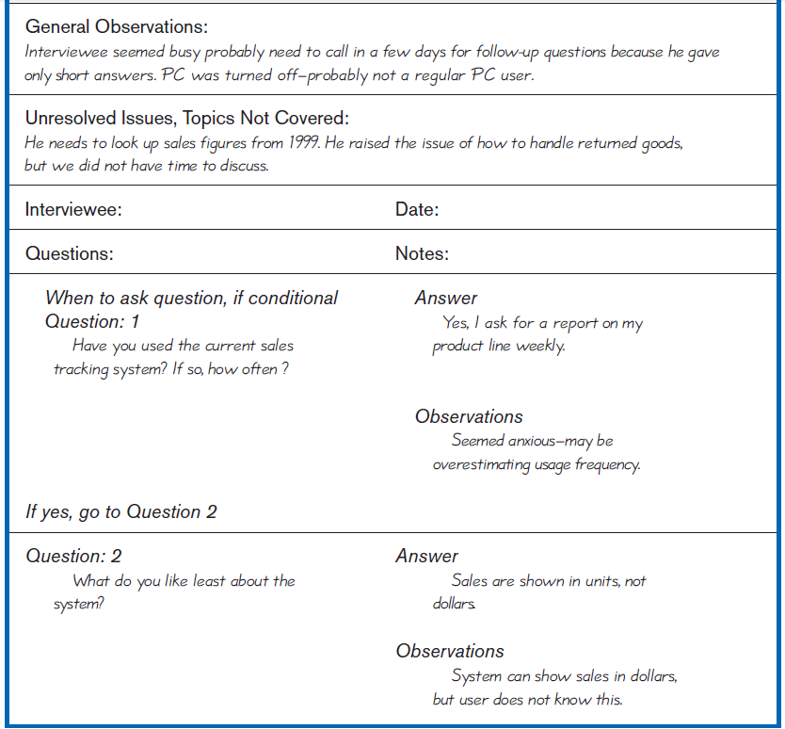
Interviewing and Listening (Cont.)
FIGURE 6-2 Typical interview guide (cont.)

Slide 15
Choosing Interview Questions
Each question in an interview guide can include both verbal and non-verbal information.
Open-ended questions: questions that have no pre-specified answers
Closed-ended questions: questions that ask those responding to choose from among a set of specified responses

Slide 16
Interviewing Guidelines
Don’t phrase a question in a way that implies a right or wrong answer.
Listen very carefully.
Type interview notes within 48 hours after the interview.
Don’t set expectations about the new system unless you know these will be deliverables.
Seek a variety of perspectives from the interviews.

Slide 17
Interviewing Groups
Drawbacks to individual interviews:
Contradictions and inconsistencies between interviewees
Follow-up discussions are time consuming
New interviews may reveal new questions that require additional interviews with those interviewed earlier

Slide 18
Interviewing Groups (Cont.)
Interviewing several key people together
Advantages
More effective use of time
Can hear agreements and disagreements at once
Opportunity for synergies
Disadvantages
More difficult to schedule than individual interviews

Slide 19
Nominal Group Technique (NGT)
A facilitated process that supports idea generation by groups
Process
Members come together as a group, but initially work separately.
Each person writes ideas.
Facilitator reads ideas out loud, and they are written on a blackboard or flipchart.
Group openly discusses the ideas for clarification.
Ideas are prioritized, combined, selected, reduced.
Used to complement group meetings or as part of JAD effort

Slide 20
Directly Observing Users
Direct Observation
Watching users do their jobs
Used to obtain more firsthand and objective measures of employee interaction with information systems
Can cause people to change their normal operating behavior
Time-consuming and limited time to observe

Slide 21
Analyzing Procedures and Other Documents
Document Analysis
Review of existing business documents
Can give a historical and “formal” view of system requirements

Slide 22
Analyzing Procedures and Other Documents (Cont.)
Types of information to be discovered:
Problems with existing system
Opportunity to meet new need
Organizational direction
Names of key individuals
Values of organization
Special information processing circumstances
Reasons for current system design
Rules for processing data

Slide 23
Analyzing Procedures and Other Documents (Cont.)
Useful document: Written work procedure
For an individual or work group
Describes how a particular job or task is performed
Includes data and information used and created in the process

Slide 24
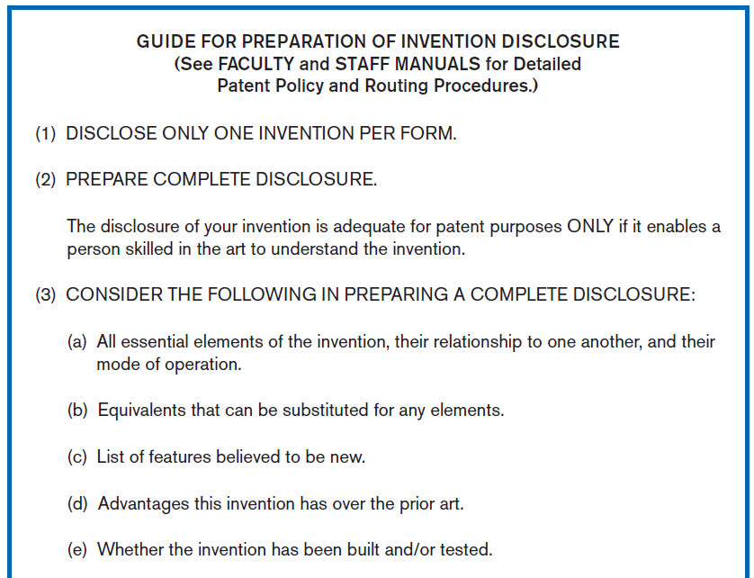
Analyzing Procedures (Cont.)
FIGURE 6-3 Example of a procedure

Slide 25
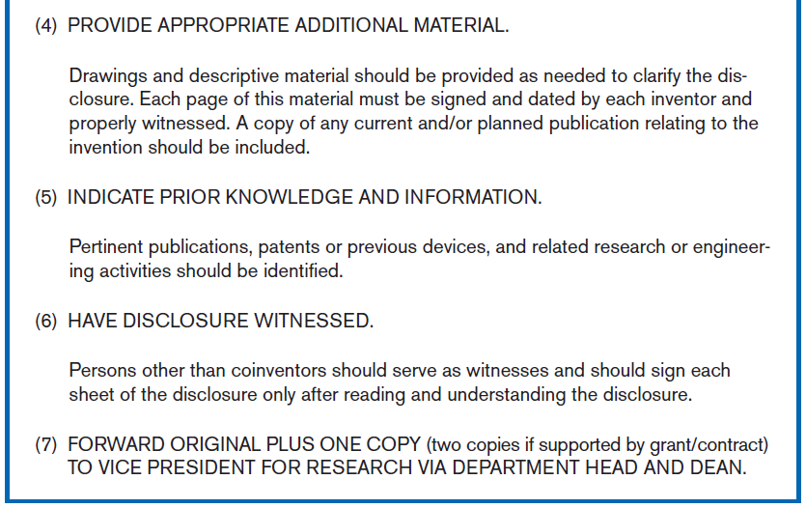
Analyzing Procedures (Cont.)
FIGURE 6-3 Example of a procedure (cont.)

Slide 26
Analyzing Procedures and Other Documents (Cont.)
Potential Problems with Procedure Documents:
May involve duplication of effort
May have missing procedures
May be out of date
May contradict information obtained through interviews

Slide 27
Analyzing Procedures and Other Documents (Cont.)
Formal Systems: the official way a system works as described in organizational documentation (i.e. work procedure)
Informal Systems: the way a system actually works (i.e. interviews, observations)

Slide 28
Analyzing Procedures and Other Documents (Cont.)
Useful document: Business form
Used for all types of business functions
Explicitly indicates what data flow in and out of a system and data necessary for the system to function
Gives crucial information about the nature of the organization

Slide 29
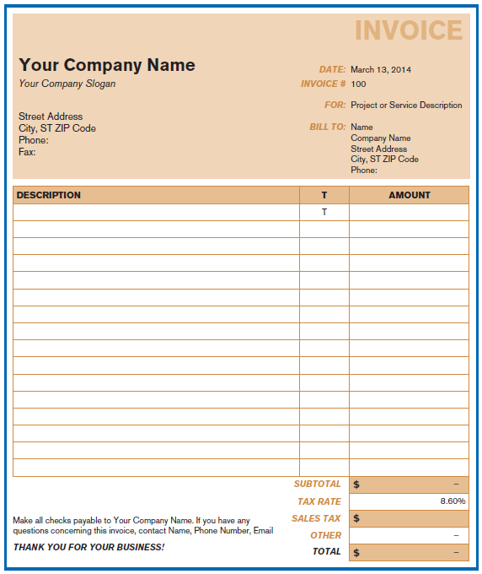
Analyzing Procedures and Other Documents (Cont.)
FIGURE 6-4
An invoice form from Microsoft Excel

Slide 30
Analyzing Procedures and Other Documents (Cont.)
Useful document: Report
Primary output of current system
Enables you to work backwards from the report to the data needed to generate it
Useful document: Description of current information system

Slide 31
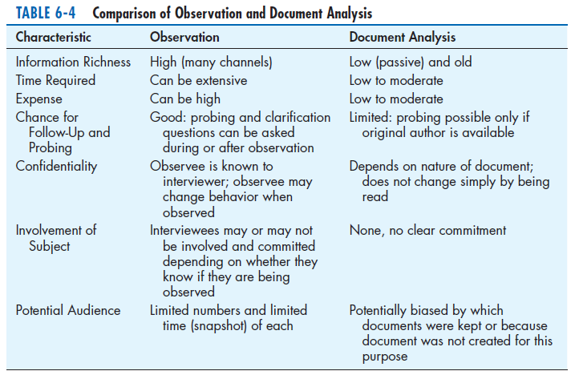
Analyzing Procedures and Other Documents (Cont.)

Slide 32
Contemporary Methods for Determining System Requirements
Joint Application Design (JAD)
Brings together key users, managers, and systems analysts
Purpose: collect system requirements simultaneously from key people
Conducted off-site
Group Support Systems
Facilitate sharing of ideas and voicing of opinions about system requirements

Slide 33
Contemporary Methods for Determining System Requirements (Cont.)
CASE tools
Used to analyze existing systems
Help discover requirements to meet changing business conditions
System prototypes
Iterative development process
Rudimentary working version of system is built
Refine understanding of system requirements in concrete terms

Slide 34
Joint Application Design (JAD)
Intensive group-oriented requirements determination technique
Team members meet in isolation for an extended period of time
Highly focused
Resource intensive
Started by IBM in 1970s

Slide 35
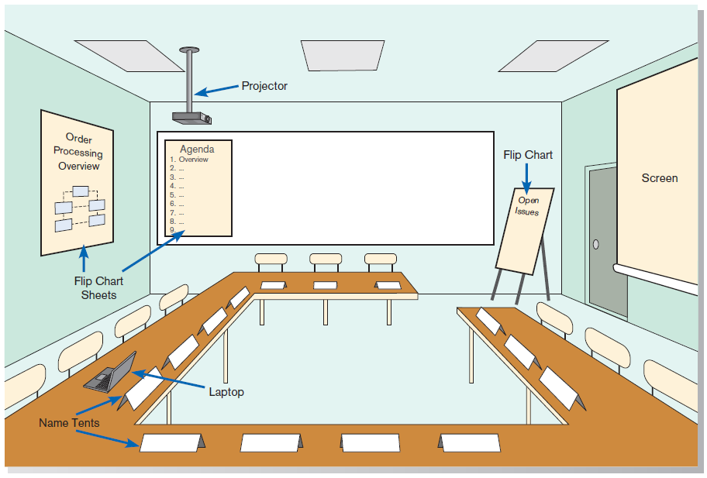
JAD (Cont.)
FIGURE 6-6 Illustration of the typical room layout for a JAD
Source: Based on Wood and Silver, 1995.

Slide 36
JAD (Cont.)
JAD Participants:
Session Leader: facilitates group process
Users: active, speaking participants
Managers: active, speaking participants
Sponsor: high-level champion, limited participation
Systems Analysts: should mostly listen
Scribe: record session activities
IS Staff: should mostly listen

Slide 37
JAD (Cont.)
End Result
Documentation detailing existing system
Features of proposed system

Slide 38
CASE Tools During JAD
CASE tools are used
Enables analysts to enter system models directly into CASE during the JAD session
Screen designs and prototyping can be done during JAD and shown to users

Slide 39
Using Prototyping During Requirements Determination
Quickly converts requirements to working version of system
Once the user sees requirements converted to system, will ask for modifications or will generate additional requests

Slide 40
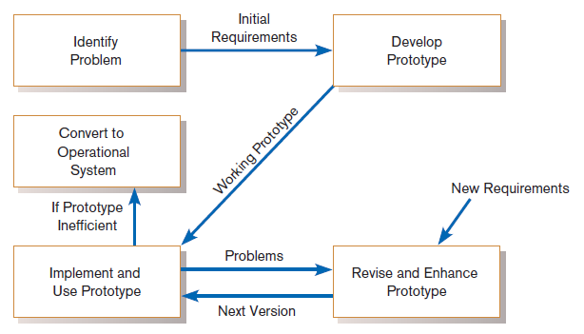
Using Prototyping During Requirements Determination (Cont.)
Figure 6-7
The prototyping methodology
(Source: Based on “Prototyping: The New
Paradigm for Systems Development,” by
J. D. Naumann and A. M. Jenkins, MIS
Quarterly 6(3): 29–44.)

Slide 41
Using Prototyping During Requirements Determination (Cont.)
Most useful when:
User requests are not clear.
Few users are involved in the system.
Designs are complex and require concrete form.
There is a history of communication problems between analysts and users.
Tools are readily available to build prototype.

Slide 42
Using Prototyping During Requirements Determination (Cont.)
Drawbacks
Tendency to avoid formal documentation
Difficult to adapt to more general user audience
Sharing data with other systems is often not considered
Systems Development Life Cycle (SDLC) checks are often bypassed

Slide 43
Radical Methods for Determining System Requirements
Business Process Reengineering (BPR): search for and implementation of radical change in business processes to achieve breakthrough improvements in products and services

Slide 44
Radical Methods for Determining System Requirements (Cont.)
Goals
Reorganize complete flow of data in major sections of an organization.
Eliminate unnecessary steps.
Combine steps.
Become more responsive to future change.

Slide 45
Identifying Processes to Reengineer
Key business processes
Structured, measured set of activities designed to produce specific output for a particular customer or market
Focused on customers and outcome
Same techniques as requirements determination are used

Slide 46
Disruptive Technologies
Information technologies must be applied to radically improve business processes.
Disruptive technologies are technologies that enable the breaking of long-held business rules that inhibit organizations from making radical business changes.

Slide 47
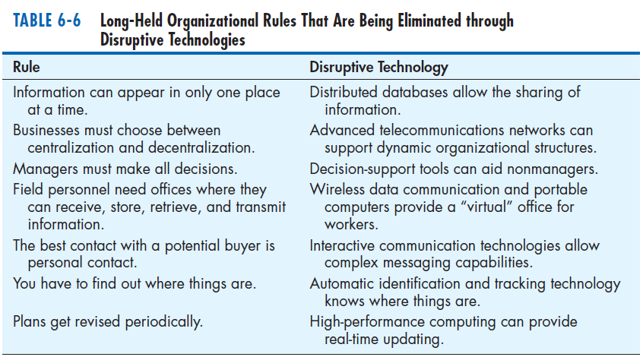
Disruptive Technologies (Cont.)

Slide 48
Requirements Determination using Agile Methodologies
Continual user involvement
Replace traditional SDLC waterfall with iterative analyze–design–code–test cycle
Agile usage-centered design
Focuses on user goals, roles, and tasks
The Planning Game
Based on eXtreme programming
Exploration, steering, commitment

Slide 49
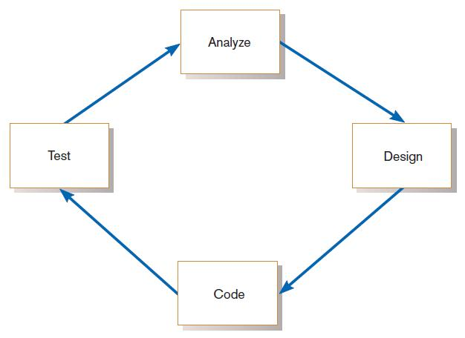
Continual User Involvement
FIGURE 6-9
The iterative analysis–design–code–test cycle

Slide 50
Agile Usage-Centered Design Steps
Gather group of programmers, analysts, users, testers, facilitator.
Document complaints of current system.
Determine important user roles.
Determine, prioritize, and describe tasks for each user role.
Group similar tasks into interaction contexts.
Associate each interaction context with a user interface for the system, and prototype the interaction context.
Step through and modify the prototype.

Slide 51
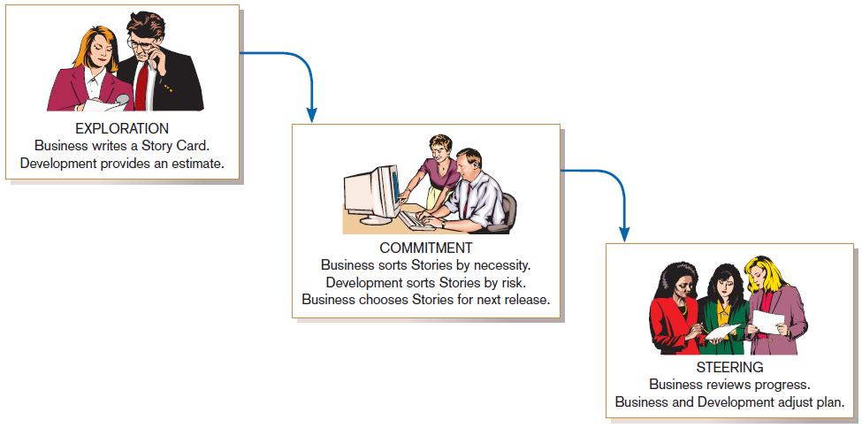
The Planning Game from eXtreme Programming
FIGURE 6-10
eXtreme Programming’s Planning Game

Slide 52
Electronic Commerce Applications: Determining System Requirements
Determining system requirements for Pine Valley furniture’s WebStore
System layout and navigation characteristics
WebStore and site management system capabilities
Customer and inventory information
System prototype evolution

Slide 53
Summary
In this chapter you learned how to:
Describe interviewing options and develop interview plan.
Explain advantages and pitfalls of worker observation and document analysis.
Explain how computing can support requirements determination.
Participate in and help plan Joint Application Design sessions.

Slide 54
Summary (Cont.)
Use prototyping during requirements determination.
Describe contemporary approaches to requirements determination.
Understand how requirements determination techniques apply to the development of electronic commerce applications.

